Slide 1
Customer care and Machine learning

Slide 2
Outline:
A Machine Learning Model for Lapse Prediction in Life Insurance Contracts by Azzone, Barucci, Giuffra, Marazzina.
New methods of customer segmentation and individual credit evaluation based on machine learning by Yuping, Guanyu, Jikova, Weisl
Marketing segmentation through machine learning models by Florez-Lopez and Ramon-Jeronimo

Slide 3
1. A Machine Learning Model for Lapse Prediction in Life Insurance Contracts
We use the Random Forest methodology to predict the lapse decision of life insurance contracts by policyholders.
We use global and local interpretability tools to investigate how the model works.
We show that non economic features (time passed from the incipit of the contract and the time to expiry, as well as the insurance company) play a significant effect in determining the lapse decision while economic/financial features (except the disposable income growth rate) play a limited effect.
The analysis shows that linear models, such as the logistic model, may not be adequate to capture the heterogeneity of financial decisions.
Barucci, E., Colozza, T., Marazzina, D., & Rroji, E. (2020) European Actuarial Journal
The determinants of lapse rates in the Italian life insurance market.
Azzone, M., Barucci, E., Giuffra, G., Marazzina, D. (submitted)
A Machine Learning Model for Lapse Prediction in Life Insurance Contracts

Slide 4
1.1 Life Insurance Contract – our dataset
The dataset considered in our analysis comes from one of the Italian largest insurance companies: it covers the 2008 - 2016 time interval with over one million life insurance contracts.
Insurance contracts in the dataset belong to two broad families: 60% are standard contracts with a guarantee (non-negative minimum guarantee rate) and 40% are unit-linked contracts.
Traditional
Traditional Insurance plans usually offer guaranteed maturity proceeds and they invest in low risk return options.
Traditional plans do not have investment options.
Unit Linked
Provides you with investment options based on your risk profile.
The contracts refer to three different companies belonging to the same insurance group.
As the companies refer to different distributors, either bank assurance relationship or financial advisors, the lapse phenomenon is company-specific because the lapse decision may be driven by commercial policies of distributors

Slide 5
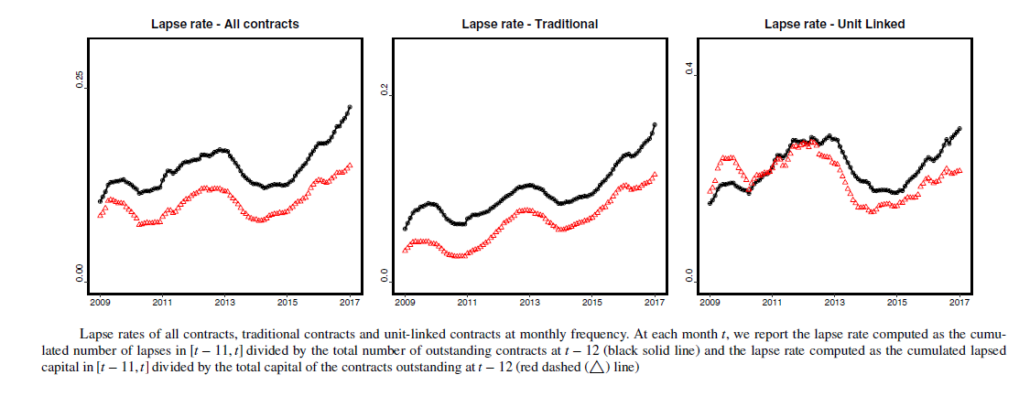
Early lapse

Slide 6
Dataset
Gender: policyholder's gender (54% male and 46% female in the dataset).
Age: age of the policyholder. We compute it as the policyholder's age at the beginning of the contract plus the time passed from the beginning of the contract.
Region: one of the 4 macro-regions where the policyholder lives, North-West (Region=1), North-East (2), Center (3), and South & Islands (4).
Company: the insurance company issuing the policy. The parent company develops its business through three companies. We identify them as company A (COMP=1), B (2), and C (3).
Time from start: the time passed from the incipit of the contract.
Time to expiry: the time left (in years) to the expiry date of the contract. We also have perpetual contracts with no expiration date (in this case we set the value of the variable to -1 in RF analysis while we consider a dummy variable in case of a logistic model to capture a perpetual contract).
Contract size: the insured capital.

Slide 7
Premium: policy premium. This variable is given by the contract size if there is only one payment and by the contract size divided by the number of payments if there are multiple payments.
Product type: the dataset contains several different types of policies, we categorized them into two classes: traditional contracts (PT=0) and unit-linked (1).
We also consider macroeconomic variables that may drive the lapse decision.
Disposable income: the yearly growth rate of Italian disposable income.
Inflation: the yearly Italian inflation rate.
Eurostoxx: the yearly growth rate of the Eurostoxx index.
For each contract, we have the following information: starting date, expiry date, and the eventual lapse date.
For each contract, we have an observation for each year in which the contract is active.
Our dataset contains 9 309 755 observations.

Slide 8
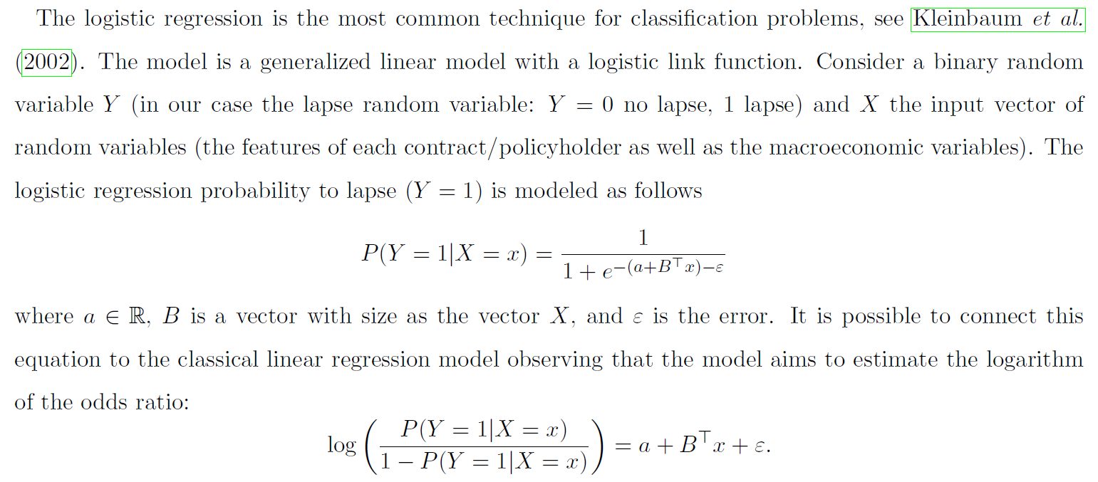
1.2 First Step – Logistic regression
We consider a binary random variable Y (the lapse random variable: Y=0 no lapse, 1 lapse)
Concerning the dataset, we consider six groups (identified by the quantiles 0.05, 0.25, 0.5, 0.75 and 0.95) for the variables Age, Time from start and Contract size, to avoid collinearity in the logistic regression.
These transformations are applied only for the logistic model - to ensure a robust regression - and not to estimate the RF.

Slide 9
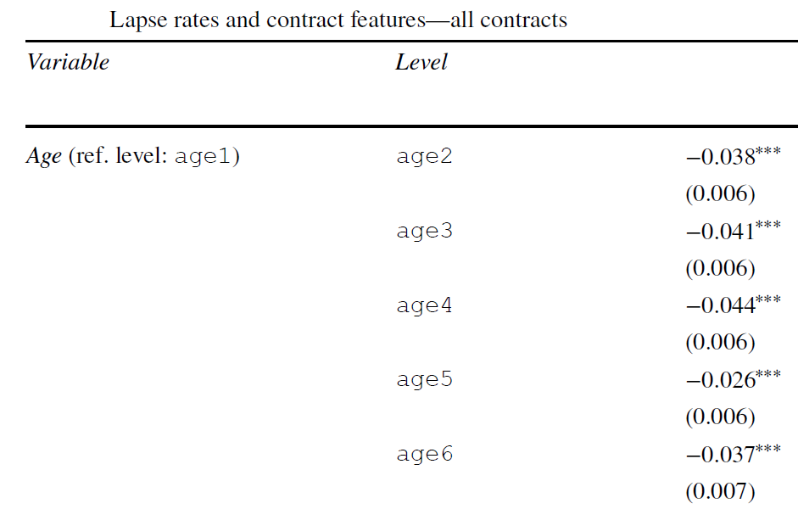
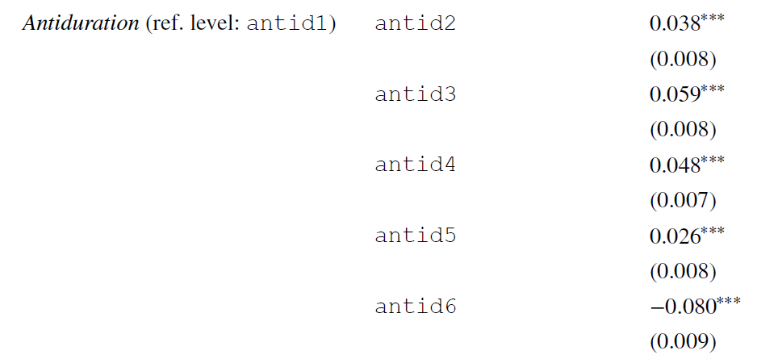

Slide 10
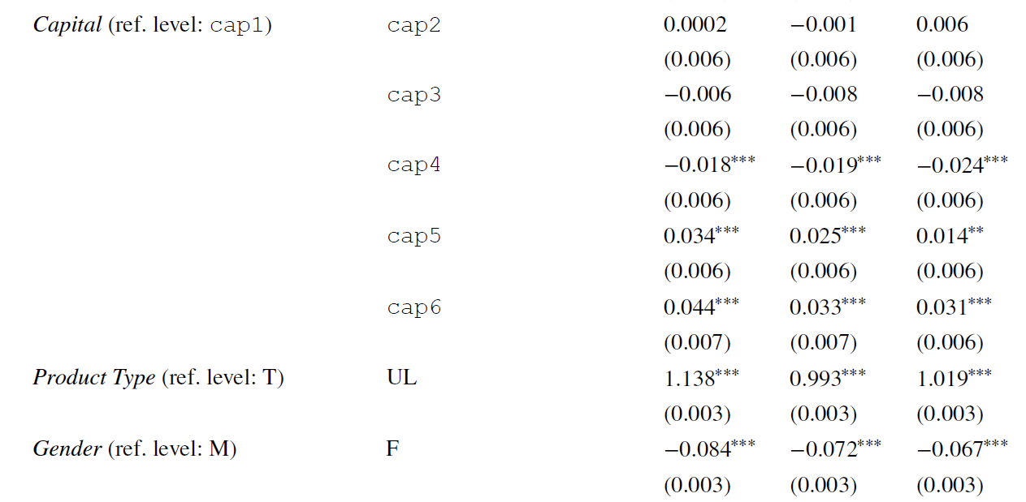
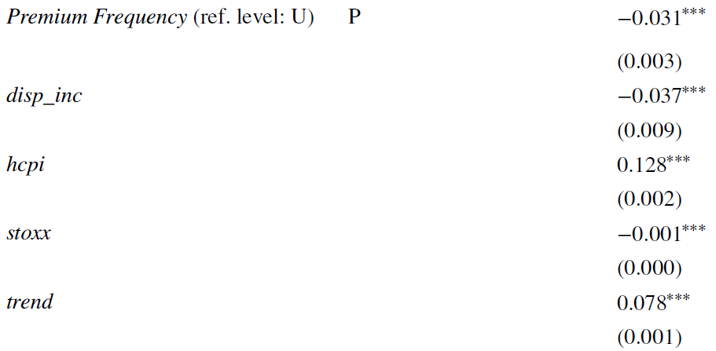
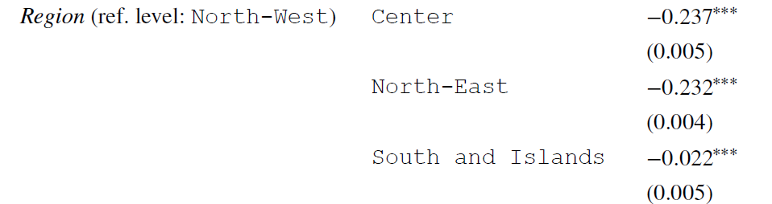

Slide 11
1.3 Research Questions
Logistic regression is good enough in predicting lapse?
Linear models (like logistic regression) are good enough to explain the agents financial decisions?

Slide 12
1.4 Machine Learning Approach: RF
Given the binary nature of the target variable, our RF classifier is based on a combination of classification trees and of tree bagging methods.
Classification trees are recursive algorithms that split the dataset into smaller sets (nodes) in a step by step fashion thanks to binary rules defined on the features of the observations.
The complete dataset is the root node of the tree. To split the node, a feature is selected and a binary rule, e.g., if the value of the feature is larger or smaller than a given threshold, is defined on it in order to obtain two disjoint datasets. These two datasets become nodes of the tree.
This procedure is repeated for each new node until a stopping criterion is met, e.g., the specified maximum depth of the tree is reached. So a classification tree is a growing tree with nodes refining the information about the exogenous variables to classify an item in the database (lapse or no lapse).

Slide 13
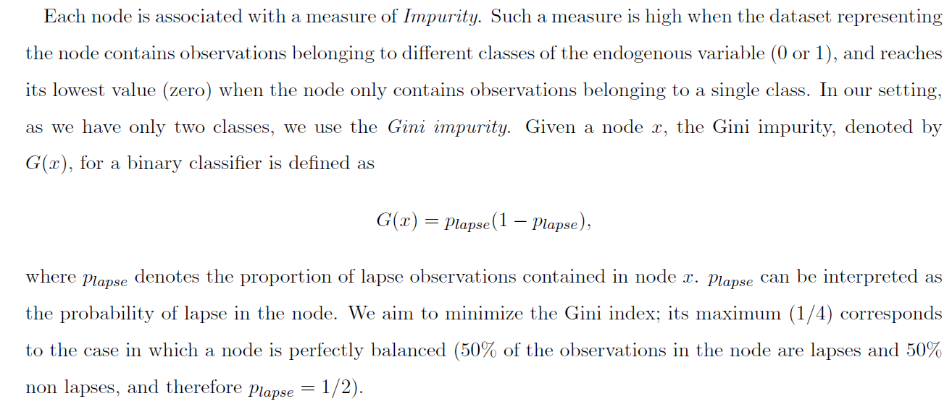
Each node is associated with a measure of Impurity. Such a measure is high when the dataset representing the node contains observations belonging to different classes of the endogenous variable (0 or 1), and reaches its lowest value (zero) when the node only contains observations belonging to a single class.
We use the Gini impurity. Given a node x, the Gini impurity for a binary classifier is
where denotes the proportion of lapse observations contained in node x.
can be interpreted as the probability of lapse in the node.
We aim to minimize the Gini impurity.

Slide 14
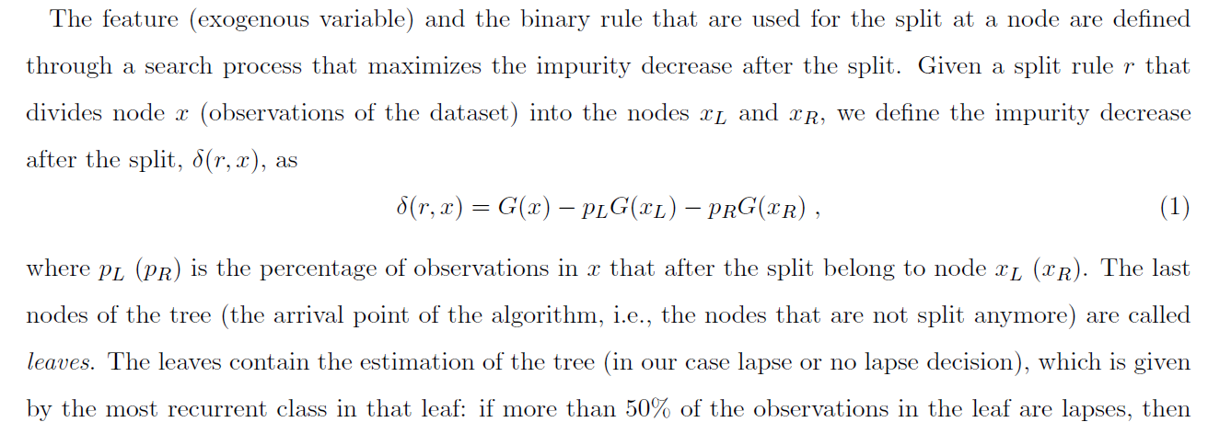
The feature (exogenous variable) and the binary rule that are used for the split at a node are defined through a search process that maximizes the impurity decrease after the split.
Given a split rule r that divides node x (observations of the dataset) into the nodes xL and xR, we define the impurity decrease after the split as
where pL is the percentage of observations in x that after the split belong to node xL.
The last nodes of the tree (the arrival point of the algorithm, i.e., the nodes that are not split anymore) are called leaves.
The leaves contain the estimation of the tree (in our case lapse or no lapse decision), which is given by the most recurrent class in that leaf: if more than 50% of the observations in the leaf are lapses, then the leaf is a lapse leaf, otherwise, it is a non-lapse leaf. We also get a probability of lapse for each leaf, given by the proportion of lapse observations in that leaf.

Slide 15
Bagging (Bootstrap Aggregation) is used to reduce the variance of classification trees.
The methodology builds several datasets from the training set choosing randomly observations with re-entry from the original dataset (statistical bootstrap). Each dataset is used to train a tree. As a result, we obtain an ensemble of trees-models and the final classifier is obtained averaging the predictions from the different trees yielding a more robust outcome than the one obtained from a single tree.
A RF classifier is an extension of the bagging methodology. The approach considers random subsets of observations (each observation consisting of the twelve features) from the original dataset and it also randomly selects the features rather than using all the features to construct each tree.
The output of the RF classifier is the probability of observing a lapse. This probability is computed averaging the predictions of all the trees, i.e., the probability of lapse is the average of the lapse probabilities given by all the classification trees in the RF.

Slide 16
To calibrate the parameters of the RF we have to set a priori some hyper-parameters.
The hyper-parameters are chosen evaluating the performance of the calibrated models on the validation set.
In our analysis we consider the following hyper-parameters:
maximum tree depth: the maximum depth for a tree;
minimum leaf size: the minimum number of observations contained in a leaf. A split will only be considered if the number of observations belonging to each child node will be higher than the threshold;
minimum decrease of impurity after a split: a node is split if it generates an impurity decrease greater than or equal to the threshold;
minimum split size: the minimum number of observations belonging to a node required to split it;
number of trees: the number of trees in the forest.

Slide 17
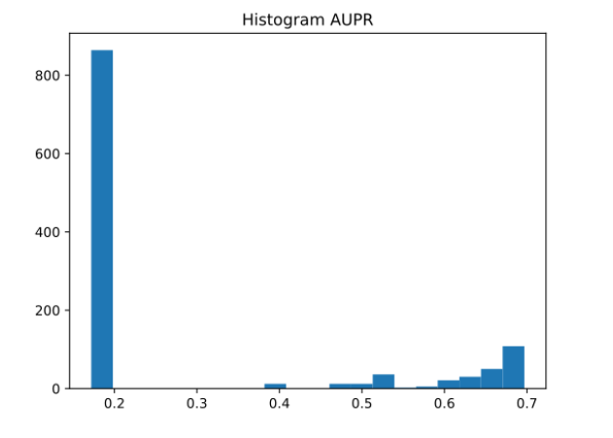
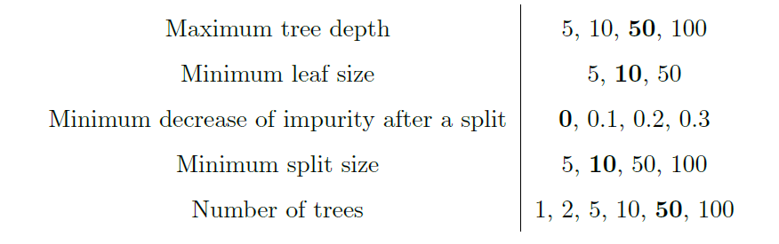
We split our dataset as follows: training set (70%), validation set (15%), test set (15%).
In the case of the logistic model, as it does not present hyper-parameters, the validation and test set are combined to evaluate the out of sample performance of the model.

Slide 18
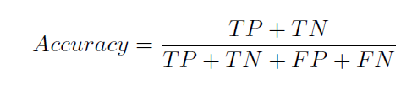
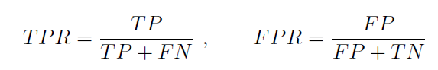
1.5 Model Selection
Accuracy (threshold 0.5 & 0.75)
ROC Curve and AUC
The Receiver Operating Characteristic (ROC) curve is built plotting the false positive rate (FPR) against the true positive rate (TPR), moving the threshold from 0 to 1.
The ROC curve illustrates the predictive ability of a binary classifier, visualizing the trade-off between TPR and FPR, and thus suggesting an optimal threshold that minimizes the misclassification error.
PR Curve and AUPR
The Precision Recall (PR) curve is obtained by plotting the Precision (the percentage of observations classified as positive that are indeed positive) against the Recall (the percentage of positive observations classified as positive) as the threshold defining the classifier output varies from 0 to 1.
The Area Under PR curve (AUPR) is the integral below the PR curve.

Slide 19
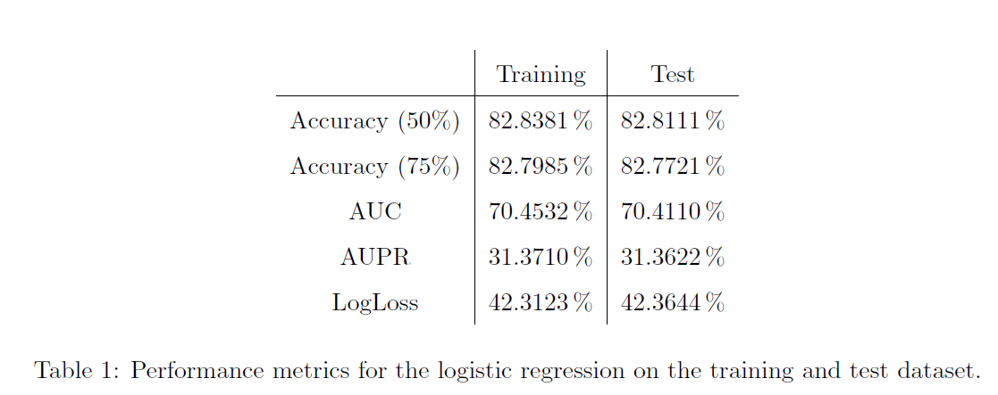
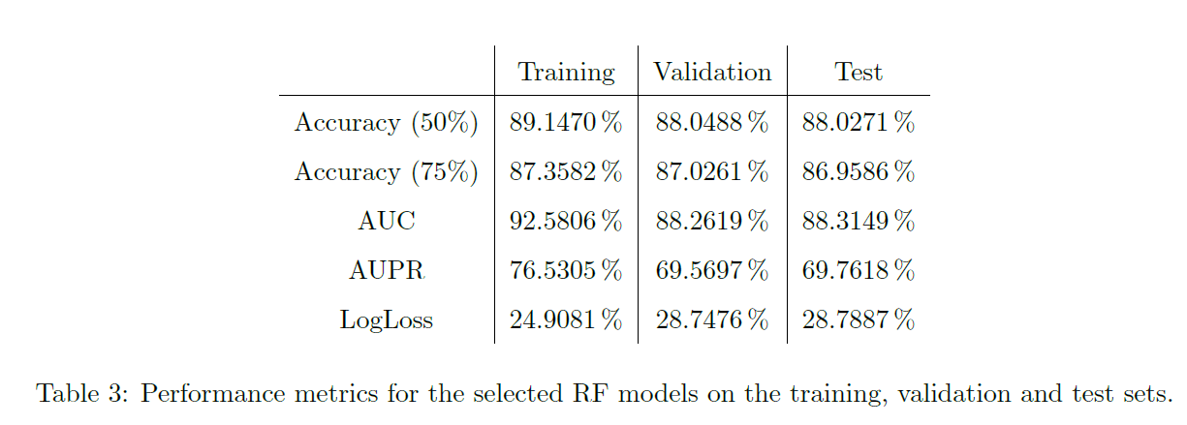

Slide 20
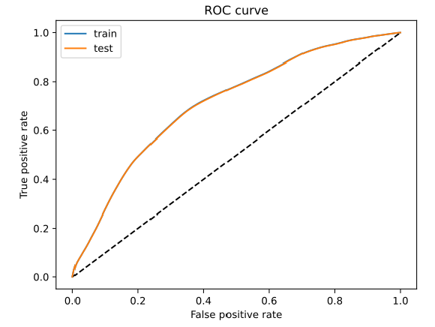
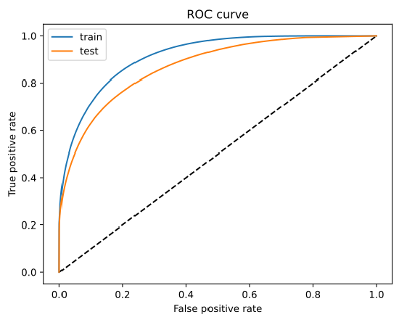

Slide 21
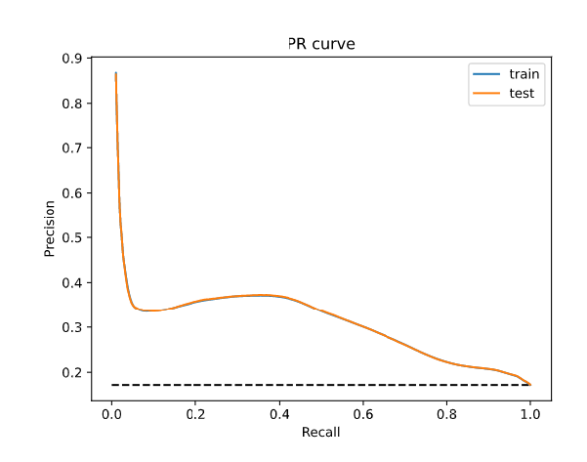
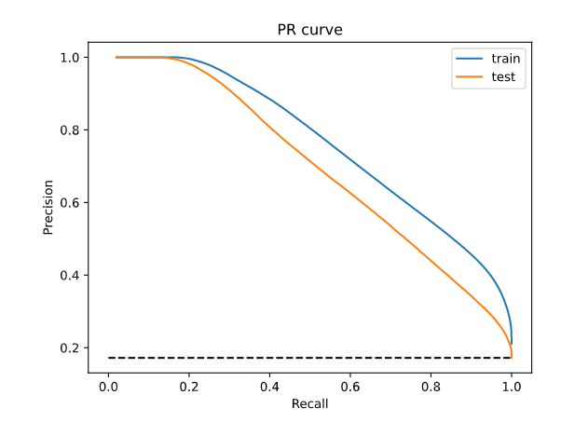

Slide 22
1.6 Interpretability
Local Interpretability
The SHAP (SHapley Additive exPlanations) method allows us to capture the impact of the different variables/features on the ML classifier output. The method borrows from cooperative game theory and consists in the calculation of SHAP value, which represents a measure of the importance of a feature.
More precisely, the SHAP value of a feature measures how much it contributes, either positively or negatively, to the classifier prediction.
The goal of the SHAP method is to explain a prediction computing the contribution of each feature to the prediction itself. The method shows the contribution of each feature to push the model output from the base value (the average model output over the training dataset) to the model output associated with the observation.

Slide 23
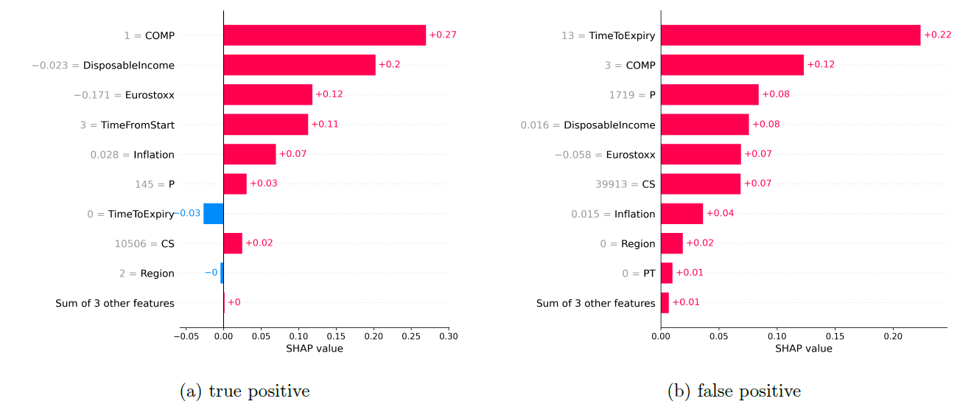
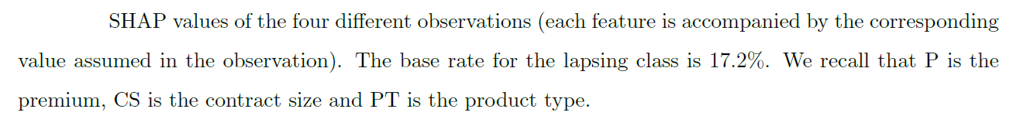
Local Interpretability

Slide 24
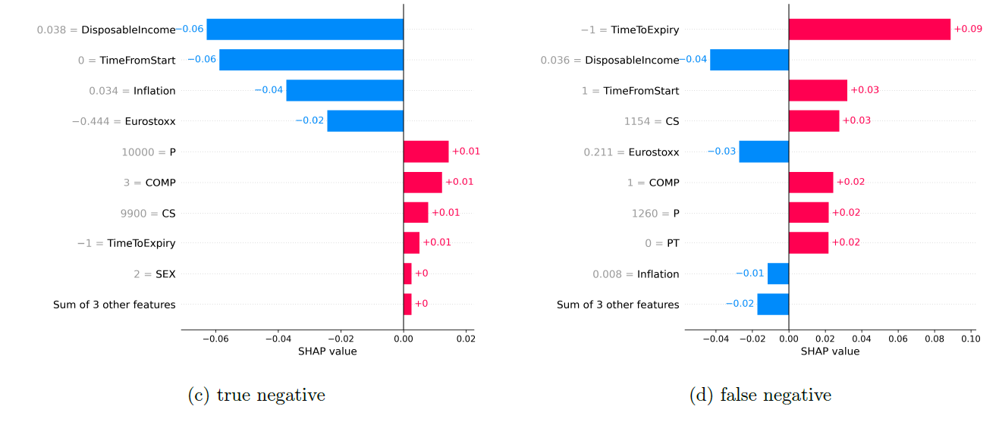

Slide 25
Global Interpretability
Local methods are useful to investigate the results connected to a specific observation. In some applications, it is interesting to have a global view of the model's behavior.
To accomplish this task, we fit a single regression tree on the predicted probabilities of our RF.
Regression trees have basically the same structure as classification trees, but the dependent variable is a continuous variable (e.g, the probability to lapse), and the measure of impurity is the MSE of the observations in the node. The quantity predicted by each leaf is the average of the values of the target variable of the observations in the leaf.
The idea is to estimate a regression tree, with low depth, in such a way that its output is as close as possible to our ``black box'' output (the outcome of the RF).
The scope is to produce a human-readable tree which is able to represent the main drivers of the ``black box'' classification.

Slide 26
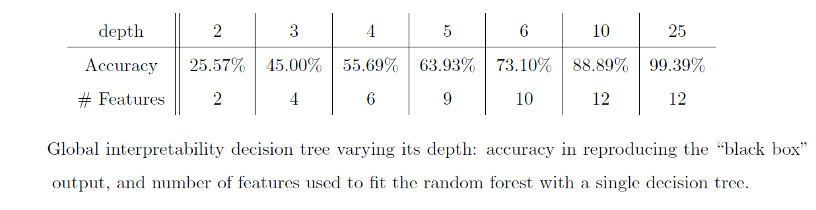

Slide 27
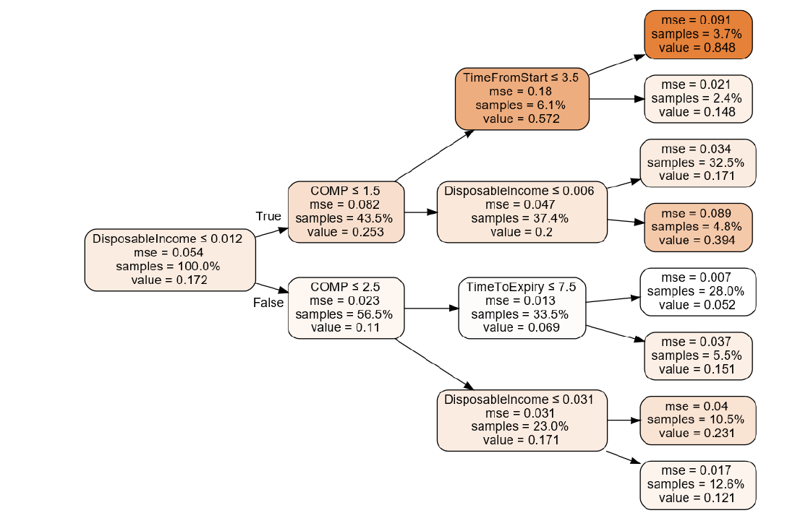

Slide 28
We notice that observations with disposable income growth rate smaller than 0.012 are more likely to lapse. We also notice the relevance of the Company (COMP) which acts at the second level of the tree. For example, if the disposable income growth rate is low and the policy is stipulated with Company A (COMP=1), then the probability to lapse increases considerably, reaching a 57% probability.
According to our analysis, the leaf with the highest lapse probability (84.8%) is obtained with a disposable income growth rate lower (or equal) than 0.012, a policy stipulated with Company A and with time from start smaller (or equal) than 3.5 years.
On the other hand, the leaf with the smallest lapse probability (5.2%) is obtained with a disposable income growth rate higher than 0.012, a policy stipulated with Company A or B, and with time to expiry smaller (or equal) than 7.5 years.
Notice that the role of disposable income growth rate is controversial: while in the first node a low disposable income growth rate results in an increase of the probability to lapse (from 17.2\% to 25.3\%), the opposite happens in the second node of the third level.
We can conclude that the contribution of the growth rate of the disposable income to the lapse decision is nonlinear and can not be fully captured through the coefficient of a linear model, as in the logistic regression. Notice that also Company A is crucial both in determining a lapse and a non-lapse event. We can conclude that the interaction among variables is truly nonlinear.
The role of the Company, e.g. launching of new products or the frequency with which products are proposed to the customers could have an important impact on the lapse decision, plays an important role.

Slide 29
1.7 Conclusions
The reason to analyze the lapse decision through ML methodologies is that the different hypotheses proposed in the literature are not able to capture adequately the phenomenon.
Behavioral and commercial reasons seem to play a significant role.
To investigate them in an agnostic way, it is useful to use ML tools that allow data to speak for themselves.
We confirm that a RF performs better than the classical logistic model to predict the lapse decision.
The ML methodology allowed us to discern the relevance of a wide set of exogenous variables:
The main result of our analysis is that the important drivers of the lapse decision are the time passed from the incipit of the contract and the time to expiry, as well as the insurance company, the contract size, and premium.
Other features of the policyholder (gender, age of the policyholder, region) or of the contracts (product type) as well as macroeconomic variables (with the exception of the disposable income growth rate with a nonlinear effect) play a limited role.

Slide 30
2. Credit scoring
The development of mobile payment platforms has revolutionised the analysis of customer behaviour
By interconnecting communication and payment platforms, it is possible to analyse interpersonal relationships in addition to purchasing behaviour.
Goal: Approving loans virtually online through mobile applications.
Case Study: SESAME CREDIT model which evaluates all users of China's most successful payment platform ALIBABA.
Traditional banks do not use interpersonal connections and behavioral references.

Slide 32
2.1 Data acquisition
Necessary information comes from the data provided by the user, such as the user registration information.
Internet data is derived from Internet finance companies such as payment, micro-credit and other data.
E-commerce data is derived from the e-commerce platform of the internet finance company, such as user trading goods, transaction amount and other transaction service data.
Public information comes from data provided by external institutions with partnerships, such as the Learning Information Network, ID card systems, etc.

Slide 33
a. Data desensitization based on dynamic desensitization technology
The sensitivity data of the credit body sample is desensitised by the dynamic desensitisation technology, and the purpose of encrypting and hiding the sensitive data in the background database can be achieved, and the sensitivity information of the client can be protected:
Data desensitisation mainly includes four aspects:
For identity data, such as email, mobile phone number, to identify.
For time and date data, remove its accuracy.
Convert text data, such as name, home address, etc, into digital data.
Logarithmic data, such as amount, etc, positive and negative floating 5% -10%.
Detection of abnormal value based on the LOF (local outlier factor) test method

Slide 34
b. Local outlier factor
Local outlier factor (LOF) is an algorithm that identifies the outliers present in the dataset. But what does the local outlier mean?
When a point is considered as an outlier based on its local neighborhood, it is a local outlier. LOF will identify an outlier considering the density of the neighborhood. LOF performs well when the density of the data is not the same throughout the dataset.
To understand LOF, we have to learn a few concepts sequentially:
K-distance and K-neighbors
Reachability distance (RD)
Local reachability density (LRD)
Local Outlier Factor (LOF)

Slide 35
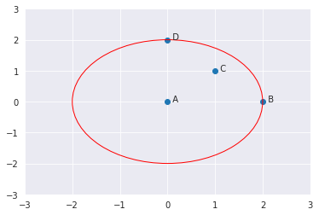
K-DISTANCE AND K-NEIGHBORS
K-distance is the distance between the point, and it’s Kᵗʰ nearest neighbor.
K-neighbors denoted by Nₖ(A) includes a set of points that lie in or on the circle of radius K-distance.
K-neighbors can be more than or equal to the value of K. How’s this possible?
We’ll see an example. Let’s say we have four points A, B, C, and D (shown below).
If K=2, K-neighbors of A will be C, B, and D. Here, the value of K=2 but the ||N₂(A)|| = 3. Therefore, ||Nₖ(point)|| will always be greater than or equal to K.

Slide 36
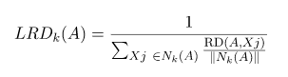
REACHABILITY DENSITY (RD)
It is defined as the maximum of K-distance of Xj and the distance between Xi and Xj.
The distance measure is problem-specific (Euclidean, Manhattan, etc.)
LOCAL REACHABILITY DENSITY (LRD)
LRD is inverse of the average reachability distance of A from its neighbors.
Intuitively according to LRD formula, more the average reachability distance (i.e., neighbors are far from the point), less density of points are present around a particular point. This tells how far a point is from the nearest cluster of points. Low values of LRD implies that the closest cluster is far from the point.

Slide 37
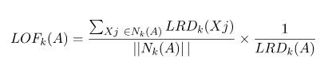
LOCAL OUTLIER FACTOR (LOF)
LRD of each point is used to compare with the average LRD of its K neighbors. LOF is the ratio of the average LRD of the K neighbors of A to the LRD of A.
Intuitively, if the point is not an outlier (inlier), the ratio of average LRD of neighbors is approximately equal to the LRD of a point (because the density of a point and its neighbors are roughly equal). In that case, LOF is nearly equal to 1. On the other hand, if the point is an outlier, the LRD of a point is less than the average LRD of neighbors. Then LOF value will be high.
Generally, if LOF> 1, it is considered as an outlier.

Slide 38
c. Improve data saturation based on the random forest method
For the sample data after deleting the outliers, the missing values are supplemented by random forest method.
K sample data sets were randomly selected, and d indexes were randomly selected to construct the training set.
For data with the same category in the training set, use the force-filling method to supplement the missing value.
The random forest model is trained by the filled training set, and the similarity matrix is counted. By analyzing the similarity degree between all the elements of the two matrices, the filling results of the missing values are determined.
The iterations are carried out 4 - 6 times, and the final missing value processing results are output.
Screening indexes based on gradient boosting decision tree method.

Slide 39
After the data loss value is supplemented by the random forest method, it is necessary to filter the indicators that have an important influence on the individual credit evaluation results to increase the accuracy of the personal credit evaluation.
In the input model of the sample data set of each index of the credit subject, the root node selects the feature of the minimum Gini index before and after the split as the feature variable, assuming that the credit card is repaid on time.
Subnodes repeat the same split mode, select sub-important feature variables in turn, and build a weak learner 1. The model error is minimised by iteratively building the final strong learner.
According to the established strong learner, the average value of the importance of feature variables in all weak learners is taken as the importance of feature variables in the model.

Slide 40
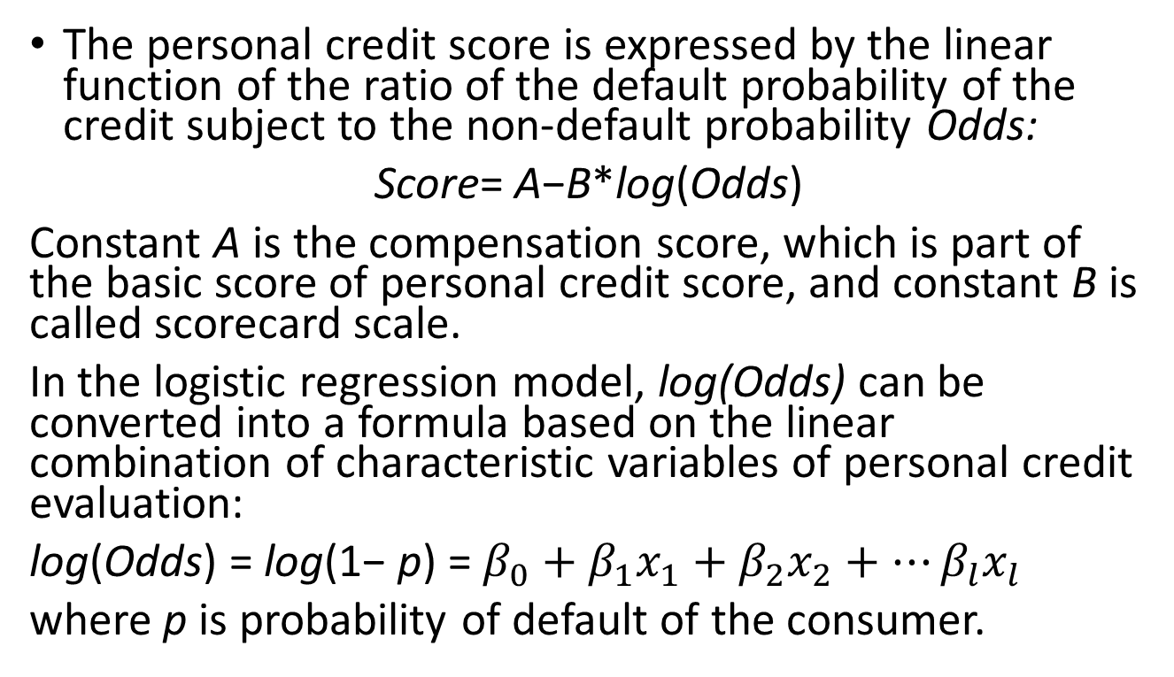
d. Scorecard model via logistic regression
The personal credit score is expressed by the linear function of the ratio of the default probability of the credit subject to the non-default probability Odds:
Score= A−B*log(Odds)
Constant A is the compensation score, which is part of the basic score of personal credit score, and constant B is called scorecard scale.
In the logistic regression model, log(Odds) can be converted into a formula based on the linear combination of characteristic variables of personal credit evaluation:
log(Odds) = log(1− p) = $β_{0}+β_{1}x_{1}+β_{2}x_{2}+…β_{l}x_{l}$
where p is probability of default of the consumer.

Slide 41
e. Scorecard model via Neural networks
Neural network is better at dealing with nonlinear complex classification problems. Its input layer and hidden layer are a process of feature extraction, while the output layer outputs the final results after processing the variables after feature extraction.
The personal credit evaluation index is extracted through the input layer and the hidden layer, and after dimension reduction, it enters the output layer and finally outputs the personal credit score.

Slide 42
e1) The design of the number of nodes in ANN
The neural network model of personal credit evaluation has three layers’ structure, including input layer, hidden layer and output layer.
The number of input layer nodes is determined by the number of pre-important indexes selected by the gradient boosting decision tree.
The number of neurons in the hidden layer affects the accuracy of the output results. The initial range of the number of neurons in the hidden layer is determined by the number of neurons in the input layer and the output layer, and then the number of hidden layer nodes is determined by the cut-and-trial method.
The input layer neuron is determined by the output result, and the output result is a personal credit score.

Slide 43
e2) Parameter setting of neural network for personal credit evaluation
There are many influencing factors on the establishment of the neural network model for personal credit evaluation , such as the number of training times of the model, error accuracy and other parameters, which will have a great impact on the output of personal credit score.
Training times: in the process of neural network training, the information is iterated continuously, and the number of iterations is the training times of neural network model.
Error accuracy: in the training process of neural network, the weight of the network is adjusted by continuous backpropagation of error, when the training error of the model reaches the maximum allowable error e, the training is stopped, and the credit maximum credit score is output.
Transfer function: in the neural network of personal credit evaluation, the general selection function Sigmoid is used as the transfer function of the hidden layer and the output layer to process the sample data of personal credit evaluation.
Learning function: in the neural network model of personal credit evaluation, the learning function selects the gradient descending momentum learning function and then adjusts the weight and threshold of the neural network.

Slide 44
e3) Training of the neural network model
After completing the basic construction of neural network model of personal credit evaluation, the model is studied and trained by inputting the sample data of personal credit evaluation. In the training process of the neural network model, through several iterations, when the error accuracy reaches the set value or the maximum training times 5000 times, the iteration is stopped, and the credit score of the credit subject is outputted. Moreover, comparing the output result of the credit principal credit score with the original credit score of the main credit body, and checking the accuracy of the model, and when the accuracy of the model reaches the present range, the residual sample can be input, and the model is further tested.

Slide 45
e4) Test of the neural network model
The remaining M - m samples are taken as test samples, and the sample data are inputted into the trained personal credit evaluation neural network model in the same way. The credit score of the test subject is outputted, the credit score of the output credit score is compared with the actual credit score of the credit subject, and the accuracy of the evaluation model is evaluated. When the accuracy of the model reaches a realistic and acceptable degree, the personal credit evaluation model is put into use. For the new sample data of the evaluation, the credit score of the credit subject is finally obtained by inputting the new sample data into the model.

Slide 46
3. Marketing segmentation through machine learning models

Slide 47
Different attributes might be used for market segmentation, which include demographic, psychographics, and socioeconomic variables. Such attributes can be classified according to two different criteria: (a) general versus product-specific bases, which are independent or dependent (respectively) of products, services, and circumstances; and (b) observable versus nonobservable bases, which are directly measured or must be deduced respectively (Table 1).
With reference to methods used for market segmentation, statistical models have been traditionally employed for customer clustering, but in previous years new tools have been used, which consider both Bayesian models and machine learning paradigms (decision trees, artificial neural networks, genetic algorithms).
It is possible to classify these according to two dimensions: (a) a priori segmentation versus post hoc segmentation and (b) predictive versus descriptive methods.

Slide 48
Descriptive techniques analyze the associations across an overall set of variables (dependent and independent ones); cluster-based methods are classical descriptive techniques of market segmentation.
Predictive techniques analyze the relationship between the set of dependent attributes and the set of independent variables.
A priori segmentation is characterized by the definition of the type and number of segments by managers, using certain heuristics or business experience; on the contrary, post hoc segmentation uses statistical techniques to identify clusters of similar customers that have similar values on a number of segmentation variables.

Slide 49
Issues:
How to select relevant attributes for identifying potential buyers, from a wide group of potential independent variables.
How to understand the logic of the model’s predictions, if they include too many explicative attributes.
How to verify initial hypotheses of statistical models in the existence of correlated attributes (independence, homoscedasticity, normality).
PCA has been widely used to reduce data dimension in order to prepare new variables that are then used as predictors in a logistic regression.
PCA has several drawbacks in terms of predictive modeling, interpretation of results and cost:
(a) PCA does not consider the relationship between the independent and dependent variables in the process of data reduction, thus irrelevant variables could be included in the model;
(b) PCA obtains components, which are difficult to interpret, in particular if a high number of variables exist;
(c) PCA requires to collect all the original predictive variables, which increases the data warehousing cost.
The interpretability problem is for the most part critical, because the management utility of a particular segmentation is directly related to be simple to interpret.

Slide 50
Feature selection has also received considerable attention from machine learning researchers and many models have been proposed: filter, wrapper, embedded approaches.
Filter methods assess the relevance of features from data alone, independently of classifiers. Their advantages are lower computation time and their independence of classifiers, but they do not concern possible interactions between the training data and the induction algorithm.
Wrapper methods employ classifier accuracy to judge if a feature subset is superior over another. They evaluate alternative feature subsets by running some induction algorithms on the training data and using the estimated accuracy of the classifier as its metrics. Usually, wrapper methods obtain better results than other methods, but they have a high computational cost and can produce overfitting because they employ the same algorithm for feature selection and classification tasks.
Embedded methods integrate the feature selection process within the basic induction algorithm. They use the specific structure of the model returned by the algorithm to get the set of relevant features. Embedded methods are easily computable, but the existence of irrelevant or correlated features can cause decreases in their accuracy). Decision trees include embedded approaches.

Slide 51
Performance measures
Financial and market measures, such as market share, profit margins, etc.
Customer-centric measures, such as customer acquisition costs, conversion rates, retention/churn rates, existing customer sales rates, loyalty measures, etc.

Slide 52
Application: direct mailing
The mailing is a direct-marketing technique that has traditionally been one of the most effective methods to present a new product or service to the market. Nevertheless, many receptors will not be interested in the offer and will not pay attention to the mailing. This negative response increases the company’s costs because promotional resources are directed to unprofitable consumers.
To address this situation, the company needs to acquire a better knowledge of their profitable clients, identifying both potential buyers and nonpotential ones, to improve the design of its promotional politics and to avoid wasting time and resources.

Slide 53
Three-stage methodology has been proposed to manage the mailing politics:
Identify the features that better characterize the customers’ behavior (observable and nonobservable variables) using embedded algorithms included in decision tree based models.
Implement a segmentation method that provides both a high performance and a satisfactory degree of interpretability for managers, testing both statistical models (discriminant analysis) and decision trees (univariate and oblique ones).
Evaluate the profitability of alternative promotional politics, using a cost–benefit function based on the Customer Profitability Accounting approach.

Slide 54
The validity of the previous proposal has been evaluated through the analysis of an empirical database which collects information on 5,822 customers from an insurance company with the aim of identifying the variables that better characterize clients who purchased a caravan insurance policy after a mailing process.
This previous segmentation will be used to develop a new promotional mailing in a different geographical location, directed to 4,000 potential new clients, to improve the positive answers rate (only 5.97% for the first 5,822 individuals) and to optimize the final profit of the company.
As a consequence, the first dataset (5,822 customers) will be used as the training set to design the CRM-CPA (Customer Relationship Management - Cost Per Acquisition) model and the second group (4,000 customers) will be employed as the validation set to verify the true performance of the proposal.
Inside the database, each customer is characterized by 85 attributes containing sociodemographic data (derived from postal zip area codes, attributes 1-43) and product ownership (attributes 44-86).

Slide 55
Data are based on an authentic business problem and includes highly correlated input variables, measured on a nominal (2), ordinal (59), interval (1), and ratio (23) scale.
For the identification of the most informative variables and the establishment of a CRM–CPA model, we have checked two different segmentation methods:
A traditional statistical approach: Discriminant analysis No PCA has been previously developed because it would require data warehouse of all potential variables and results could not be directly understood.
Linear discriminant analysis (LDA) is a method used in statistics and other fields, to find a linear combination of features that characterizes or separates two or more classes of objects or events. The resulting combination may be used as a linear classifier, or, more commonly, for dimensionality reduction before later classification.

Slide 56
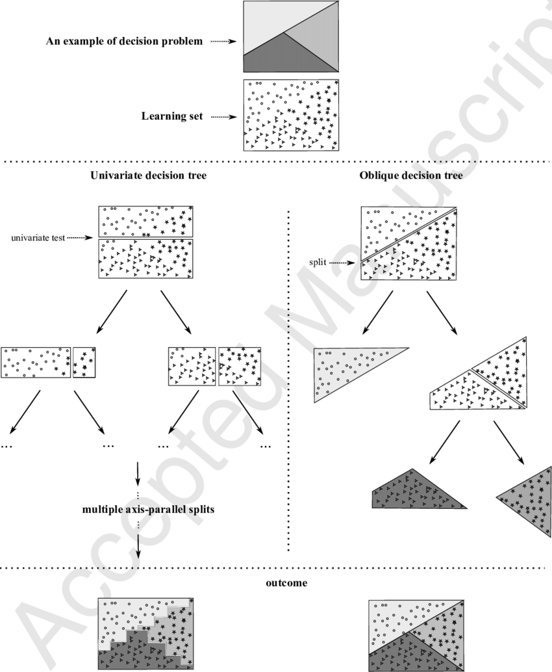
Univariate and oblique decision trees: The CART model (both univariate and oblique variants), using the Gini splitting rule and a pruning technique based on cross-validation. A minimum restriction of 5% examples per leaf has been imposed to reduce overfitting.

Slide 59
Results

